Slide 1
PAI 724:
Data Driven Decision making
LAB
Week 11
November 14, 2022

Slide 2
Lecture Topic
Revisiting last week’s R lesson with
Excel

Slide 3
In-class Excel exercise
Data: Lesson_11_EJ_Data.xlsx

Slide 4
In-class Excel exercise
Data: Lesson_11_EJ_Data.xlsx
Goal:
Produce a figure showing the variation in the year to year means and standard deviation in the number of statements made by each position across sectors between 2011 and 2021.

Slide 5
In-class Excel exercise
Data: Lesson_11_EJ_Data.xlsx
Goal:
Produce a figure showing the variation in the year to year means and standard deviation in the number of statements made by each position across sectors between 2011 and 2021.
Type of Graph: Line
X-Axis: Years
Y-Axis: mean number of statements
Variation:
  Observation Unit: Each position
  Comparison: Sector

Slide 6
How’s Our Data?
Goal
Type of Graph: Line
X-Axis: Years
Y-Axis: mean number of statements
Variation:
  Observation Unit: Each position
  Comparison: Sector
Data
Observation Unit / Standard deviation?
Columns
State
Year | X-Axis Variation
Month
Satem_Num
Part_Sec | Comparison
Part_Position | Observation Unit
types
→ a count of rows, since each row is a statements

Slide 7
How’s Our Data?
Appointed
Citizens
Aff Com 1
Aff Com 2
App Cit 1
App Cit 2
App Cit 3
Goal
Type of Graph: Line
X-Axis: Years
Y-Axis: mean number of statements
Variation:
  Comparison: Sector
  Standard deviation: Each position’s mean in each year
Data
Observation Unit / Standard deviation?
Columns
State
Year | X-Axis Variation
Month
Satem_Num
Part_Sec | Comparison
Part_Position | Observation Unit
types
15
1
9
8
21
Agency Delegates
Enviro.
Transpo.
Develop.
Health
Ag.
2
5
2
4
13
→ a count of rows, since each row is a statements

Slide 8
How’s Our Data?
Appointed
Citizens
Aff Com 1
Aff Com 2
App Cit 1
App Cit 2
App Cit 3
Goal
Type of Graph: Line
X-Axis: Years
Y-Axis: mean number of statements
Variation:
  Comparison: Sector
  Standard deviation: Each position’s mean in each year
Data
Standard deviation?
Yearly Mean
Columns
State
Year | X-Axis Variation
Month
Satem_Num
Part_Sec | Comparison
Part_Position | Standard deviation
types
15
1
9
8
21
Agency Delegates
Enviro.
Transpo.
Develop.
Health
Ag.
Yearly Mean
2
5
2
4
13
→ a count of rows, since each row is a statements

Slide 9
How’s Our Data?
Appointed
Citizens
Aff Com 1
Aff Com 2
App Cit 1
App Cit 2
App Cit 3
Goal
Type of Graph: Line
X-Axis: Years
Y-Axis: mean number of statements
Variation:
  Comparison: Sector
  Standard deviation: Each position’s mean in each year
Data
Standard deviation?
Yearly Mean
Columns
State
Year | X-Axis Variation
Month
Satem_Num
Part_Sec | Comparison
Part_Position | Standard deviation
types
Standard Deviation
Agency Delegates
Enviro.
Transpo.
Develop.
Health
Ag.
Yearly Mean
Standard Deviation
→ a count of rows, since each row is a statements

Slide 10
Data Manipulation
Question:
Give our data, what do we need to do first?

Slide 11
Data Manipulation
Question:
Give our data, what do we need to do first?
We need to calculate the number of statements for each position, sector, and year.

Slide 12
Data Manipulation
Question:
Give our data, what do we need to do first?
We need to calculate the number of statements for each position, sector, and year.
Appointed
Citizens
Aff Com 1
Aff Com 2
App Cit 1
App Cit 2
App Cit 3
Agency Delegates
Enviro.
Transpo.
Develop.
Health
Ag.
In 2011…
15
1
9
8
21
2
5
2
4
13

Slide 13
Data Manipulation
Question:
Give our data, what do we need to do first?
We need to calculate the number of statements for each position, sector, and year.
In R:
group_by() to group by position, sector, and year
summarize() and n() to count the number of rows given the aggregation set in (1)
In Excel:
???

Slide 14
Data Manipulation
Question:
Give our data, what do we need to do first?
We need to calculate the number of statements for each position, sector, and year.
In R:
group_by() to group by position, sector, and year
summarize() and n() to count the number of rows given the aggregation set in (1)
In Excel:
=COUNTIFS() to count the number of rows conditional on position, sector, and year

Slide 15
Data Manipulation
=COUNTIFS(range_1, cond_1, range_2, cond_2, …)

Slide 16
Code Break

Slide 17
Data Manipulation
Question:
Now that we have the number of statements calculated for each position, sector, and year;
what do we need to do?

Slide 18
Data Manipulation
Question:
Now that we have the number of statements calculated for each position, sector, and year;
what do we need to do?
Ungroup, regroup the data for year and sector, and calculate the standard deviation and mean.

Slide 19
Data Manipulation
Question:
Now that we have the number of statements calculated for each position, sector, and year;
what do we need to do?
Ungroup, regroup the data for year and sector, and calculate the standard deviation and mean.
Appointed
Citizens
Aff Com 1
Aff Com 2
App Cit 1
App Cit 2
App Cit 3
Agency Delegates
Enviro.
Transpo.
Develop.
Health
Ag.
In 2011…
Yearly Mean
Yearly Mean
Standard Deviation
Standard Deviation

Slide 20
Data Manipulation
Question:
Now that we have the number of statements calculated for each position, sector, and year;
what do we need to do?
Ungroup, regroup the data for year and sector, and calculate the standard deviation and mean.
In R:
ungroup()
group_by() to group by sector, and year
summarize(), mean(), and sd() to find the mean and SD given the aggregation set in (2)
In Excel:
???
???

Slide 21
Data Manipulation
Question:
Now that we have the number of statements calculated for each position, sector, and year;
what do we need to do?
Ungroup, regroup the data for year and sector, and calculate the standard deviation and mean.
In R:
ungroup()
group_by() to group by sector, and year
summarize(), mean(), and sd() to find the mean and SD given the aggregation set in (2)
In Excel:
=AVERAGEIFS() to find the average conditional on sector, and year
???

Slide 22
Data Manipulation
Question:
Now that we have the number of statements calculated for each position, sector, and year;
what do we need to do?
Ungroup, regroup the data for year and sector, and calculate the standard deviation and mean.
In R:
ungroup()
group_by() to group by sector, and year
summarize(), mean(), and sd() to find the mean and SD given the aggregation set in (2)
In Excel:
=AVERAGEIFS() to find the average conditional on sector, and year
=STDEV(IF() ) to find the standard deviation conditional on sector, and year

Slide 23
Data Manipulation
= AVERAGEIFS(mean_range, range_1, cond_1, range_2, cond_2, …)
= STDEV(IF((range_1, cond_1)*(range_2, cond_2, …), stdev_range))

Slide 24
Data Manipulation
= AVERAGEIFS(mean_range, range_1, cond_1, range_2, cond_2, …)
= STDEV(IF((range_1, cond_1)*(range_2, cond_2, …), stdev_range))
= STDEV(IF((TRUE)*(TRUE), pass number to STDEV))
= STDEV(IF((FALSE)*(TRUE), DO NOT pass number to STDEV))
= STDEV(IF((TRUE)*(FALSE), DO NOT pass number to STDEV))

Slide 25
Code Break

Slide 26
In-class R exercise Round 2
Data: Lesson_11_EJ_Data.xlsx
Goal:
Produce a figure showing the variation in the year to year means and standard deviation in the number of statements made by each position across sectors for each type of statement between 2011 and 2021.
Type of Graph: Line
X-Axis: Years
Y-Axis: mean number of statements
Variation:
  Observation Unit: each type of statement for Each position
  Comparison: Sector

Slide 27
Data Manipulation
Appointed
Citizens
Aff Com 1
Aff Com 2
App Cit 1
App Cit 2
App Cit 3
Ann
Discuss
Ask_Answer
Ann
Discuss
Ask_Answer
Ann
Discuss
Ask_Answer
Ann
Discuss
Ask_Answer
Ann
Discuss
Ask_Answer
9
5
1
8
1
8
6
0
7
2
1
4
2
5
9

Slide 28
Code Break

Slide 29
Data Manipulation
Yearly Ann Mean
Appointed
Citizens
Aff Com 1
Aff Com 2
App Cit 1
App Cit 2
App Cit 3
Ann
Discuss
Ask_Answer
Ann
Discuss
Ask_Answer
Ann
Discuss
Ask_Answer
Ann
Discuss
Ask_Answer
Ann
Discuss
Ask_Answer
Yearly Discuss Mean
Yearly Ask_Answer Mean
Standard Deviation
Standard Deviation
Standard Deviation

Slide 30
Code Break

Slide 31
Lecture Topic
Writing about figures

Slide 32
Writing about figures
What to discuss:
Introduce the figure
Identify the data the figure presents
Present what you see as key take-aways from each figure

Slide 33
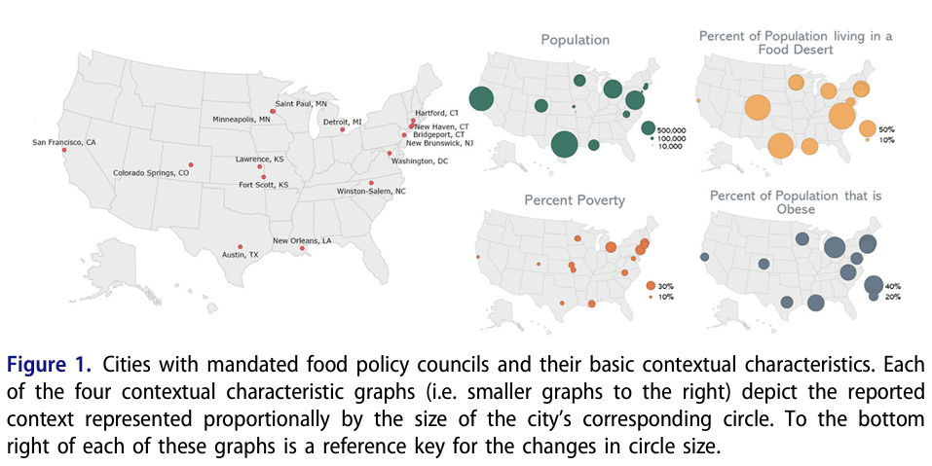

Slide 34
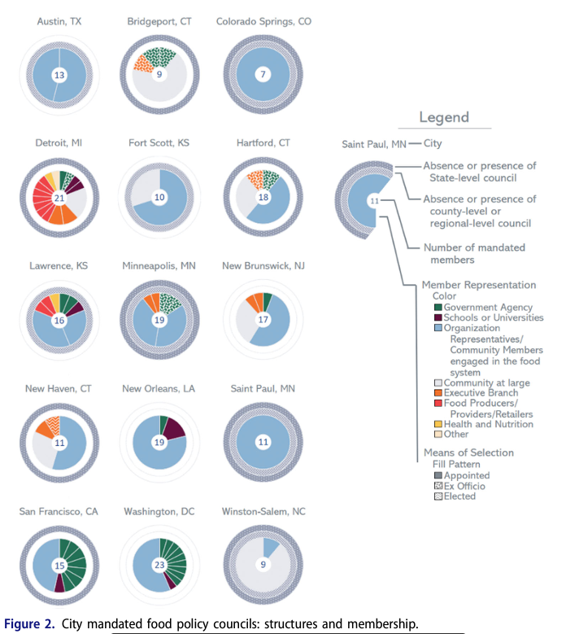

Slide 35
