Slide 1
PAI 724:
Data Driven Decision making
LAB
Week 7
October 17, 2021

Slide 2
Lecture Topic
Dictionaries

Slide 3
Dictionaries
Way to store “bag of values”
Operate on key-value pairs (or items)
Versatile
Mutable

Slide 4
General structure
dictionary = dict ( )
variable [‘a’] = x
variable [‘b’] = y
Create dictionary
Key
Value
Key-value pair

Slide 5
Code Break

Slide 6
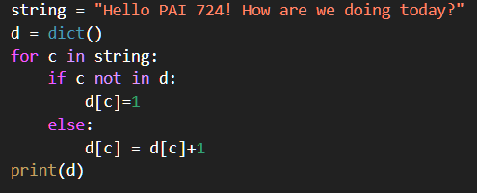
Common functions
Counting words in text
d = {}
We establish an empty dictionary d

Slide 7
Common functions
Counting words in text
d = {}
We establish each letter of our string as an iteration variable ‘c’

Slide 8
Common functions
Counting words in text
d = {}
If the letter is not in d, we place it in the dictionary as a key with a value of 1

Slide 9
Common functions
Counting words in text
d = {}
If the letter is not in d, we place it in the dictionary as a key with a value of 1
If the letter is in d, we add one to the current value

Slide 10
Common functions
Counting words in text
d = {}
‘H’ is not in d
we place ‘H’ as a key and 1 as a value in d
d = {‘H’: 1}

Slide 11
Common functions
Counting words in text
d = {‘H’:1}
‘e’ is not in d
we place ‘e’ as a key and 1 as a value in d
d = {‘H’: 1, ‘e’: 1}

Slide 12
Common functions
Counting words in text
d = {‘H’: 1, ‘e’: 1}
‘l’ is not in d
we place ‘l’ as a key and 1 as a value in d
d = {‘H’: 1, ‘e’: 1, ‘l’: 1 }

Slide 13
Common functions
Counting words in text
d = {‘H’: 1, ‘e’: 1, ‘l’: 1 }
‘l’ is in d
we add 1 ‘l’s current value
d = {‘H’: 1, ‘e’: 1, ‘l’: 2 }

Slide 14
Code Break

Slide 15
Common functions
itervar.translate(itervar.maketrans(x,y,z))
X = the characters to be replaced
Y = the characters doing the replacing
Z = the characters to be deleted

Slide 16
Common functions
itervar.translate(itervar.maketrans(x,y,z))
X = the characters to be replaced
Y = the characters doing the replacing
Z = the characters to be deleted
itervar.translate(itervar.maketrans(‘’, ‘’,z))

Slide 17
Code Break

Slide 18
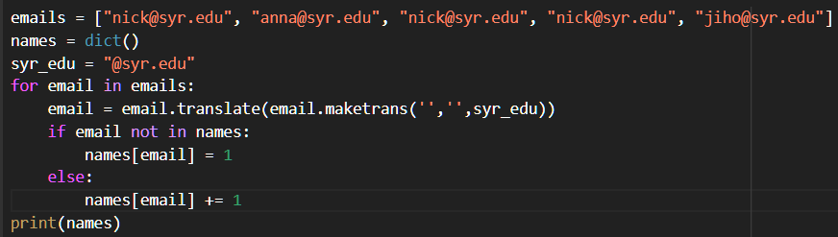
Common functions
maketrans(x,y,z)
In the first iteration:
email = ‘nick@syr.edu’
Given maketrans(x,y,z) we remove syr_edu
Leaving →
email = ‘nick’

