Slide 1
PAI 724: Data Driven Decision making LAB
Week 6
October 10, 2022

Slide 2
Lecture Topic
Files and Lists

Slide 3
Files

Slide 4
Files
Retrieving and manipulating data from files
Retrieved data can be read, processed or manipulated

Slide 5
Opening files
with open(“file path”, mode) as variable:

Slide 6
Opening files
“Handle” that stores files information
with open(“file path”, mode) as variable:
Built in Python function for opening files
Indicates what you want to do with the file:
“r” = read
“w” = write
Default is read

Slide 7
Code Break

Slide 8
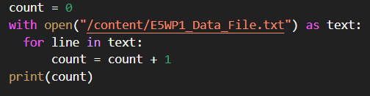
Interacting With data from files

Slide 9
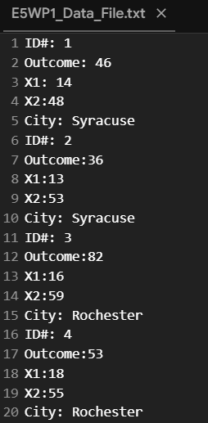
Interacting With data from files
Text

Slide 10
Interacting With data from files
Text
1
2
3
4
5
6
7
8
9
10
11
12
13
14
15
16
17
18
19
20

Slide 11
Interacting With data from files
Text
1
0
1
2
3
4
5
6
7
8
9
10
11
12
13
14
15
16
17
18
19
20

Slide 12
Interacting With data from files
1
Text
2
1
1
2
3
4
5
6
7
8
9
10
11
12
13
14
15
16
17
18
19
20

Slide 13
Interacting With data from files
2
Text
3
2
1
2
3
4
5
6
7
8
9
10
11
12
13
14
15
16
17
18
19
20

Slide 14
Code Break

Slide 15
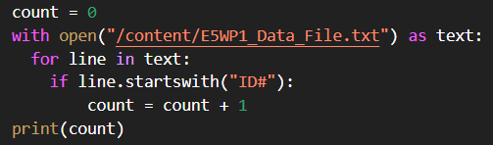
Interacting With data from files

Slide 16
Interacting With data from files
Text
1
2
3
4
5
6
7
8
9
10
11
12
13
14
15
16
17
18
19
20

Slide 17
Interacting With data from files
Text
1
2
3
4
5
6
7
8
9
10
11
12
13
14
15
16
17
18
19
20
1
0

Slide 18
Interacting With data from files
1
Text
1
2
3
4
5
6
7
8
9
10
11
12
13
14
15
16
17
18
19
20
1
0

Slide 19
Interacting With data from files
1
Text
1
2
3
4
5
6
7
8
9
10
11
12
13
14
15
16
17
18
19
20
1
0

Slide 20
Interacting With data from files
1
Text
1
2
3
4
5
6
7
8
9
10
11
12
13
14
15
16
17
18
19
20
2
1

Slide 21
Code Break

Slide 22
Lists

Slide 23
lists
Sequences of values
Values can be float, integer, or string
Values in lists referred to as “items” or “elements”
Values in lists can be indexed
Lists can nest within other lists
Lists are mutable

Slide 24
List structures
[x, y, z] Sequence of float or integer values
[‘x’, ‘y’, ‘z’] Sequence of string values
[u, v, w, [x, y, z]] Sequences of values in other sequences. * Nested sequences count as single elements
a = [x, y, z] Sequences of values assigned to variables
[ ] Empty list
Indexing
Also with [ ] => a[0] = x

Slide 25
Mutability in lists
Can replace values in lists using bracket operator on the left of assignment

Slide 26
Code Break

Slide 27
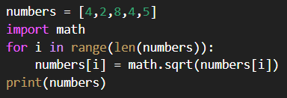
Traversing lists
5
len gives us the length of the list ‘numbers’

Slide 28
Traversing lists
[0,1,2,3,4]
Range converts our length to a list of positions with the same length

Slide 29
Traversing lists
[0,1,2,3,4]
for position 0 in the list numbers:
= math.sqrt(4)
= 2
What does the left-hand side of the equal side tell us?
Where will python place ‘2’?
0
0

Slide 30
Traversing lists
2
[0,1,2,3,4]
for position 0 in the list numbers:
= math.sqrt(4)
= 2
What does the left-hand side of the equal side tell us?
Where will python place ‘2’?
→ In numbers[0]
0
0

Slide 31
Traversing lists
2,1.414,8,4,5]
[0,1,2,3,4]
for position 1 in the list numbers:
= math.sqrt(2)
= 1.414
1
1

Slide 32
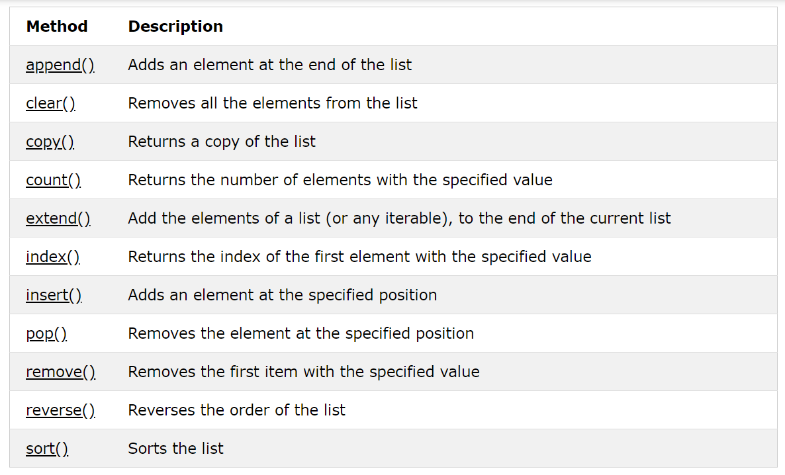
List methods

Slide 33
Code Break

